Slide 1
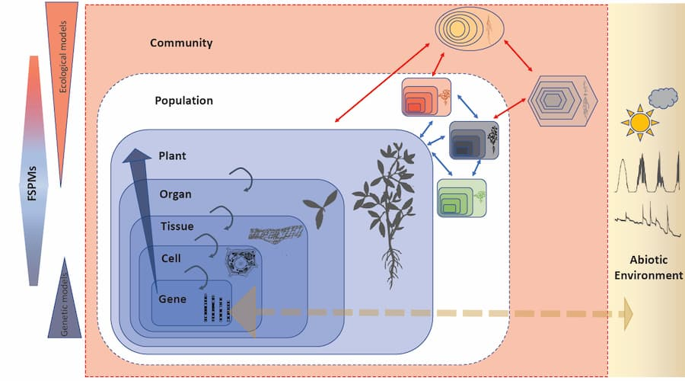
Louran and song, 2020; Two decades of functional–structural plant modelling: now addressing fundamental questions in systems biology and predictive ecology

Slide 2
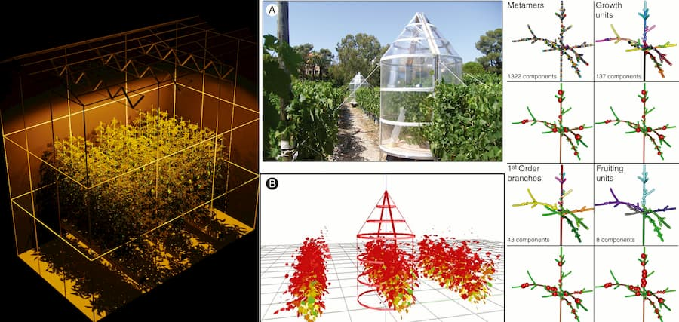
Some of the highlighted recent studies discussed by Louarn and Song 2020
are about lamp placement for tomatoes in greenhouses (left),
different training systems of vine plants (middle) and
multi-scale carbon allocation model (MuSCA) for apple trees (right).

Slide 3

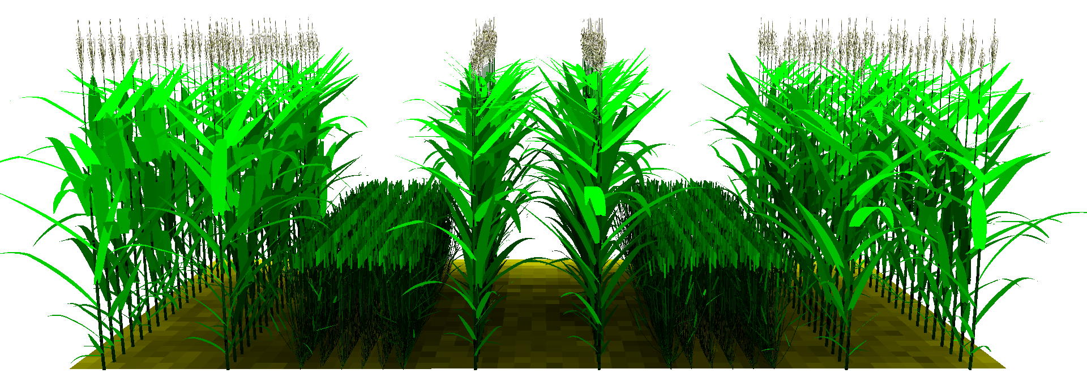
Plant plasticity in intercropping: mechanisms and consequences
Junqi Zhu 2015
Notes:
Few words on my phd work.
16

Slide 4
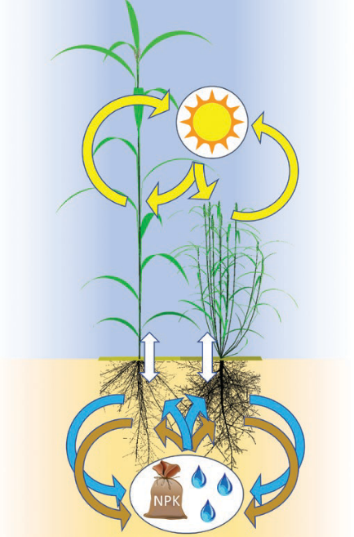
Evers et al., 2018;JXB; Understanding and optimizing species
mixtures using functional–structural plant modelling

Slide 5
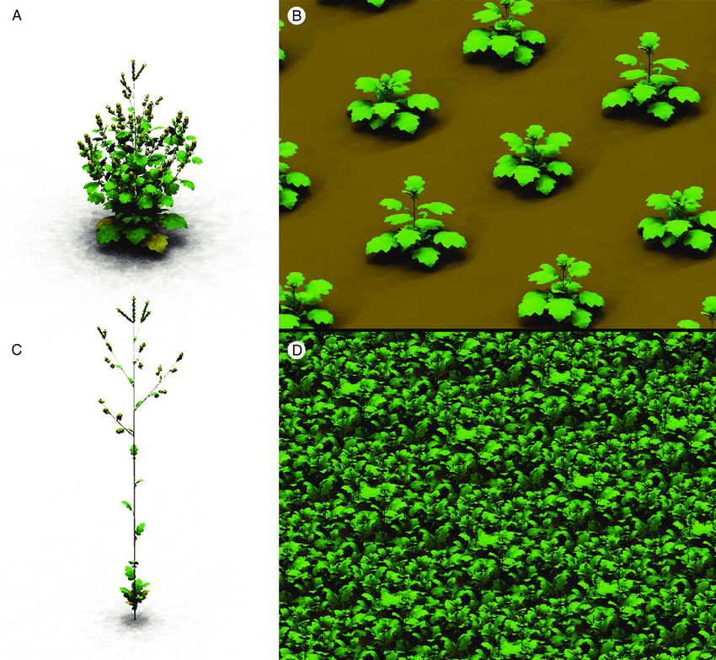
Elucidating the interaction between light competition and herbivore
feeding patterns using functional–structural plant modelling
de Vries et al., 2018

Slide 6
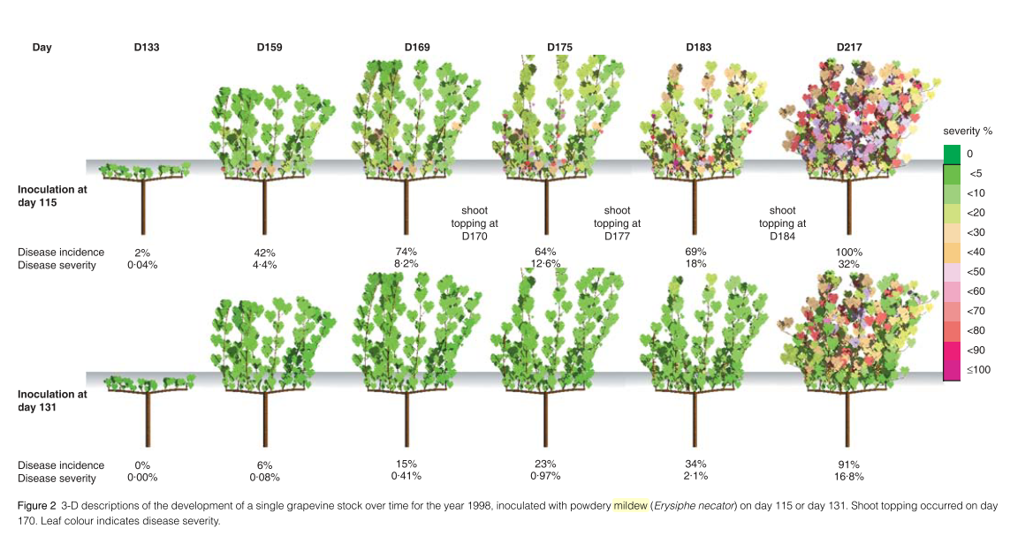
Calonnec et al., 2008

Slide 7
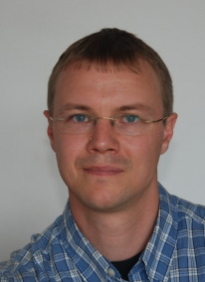
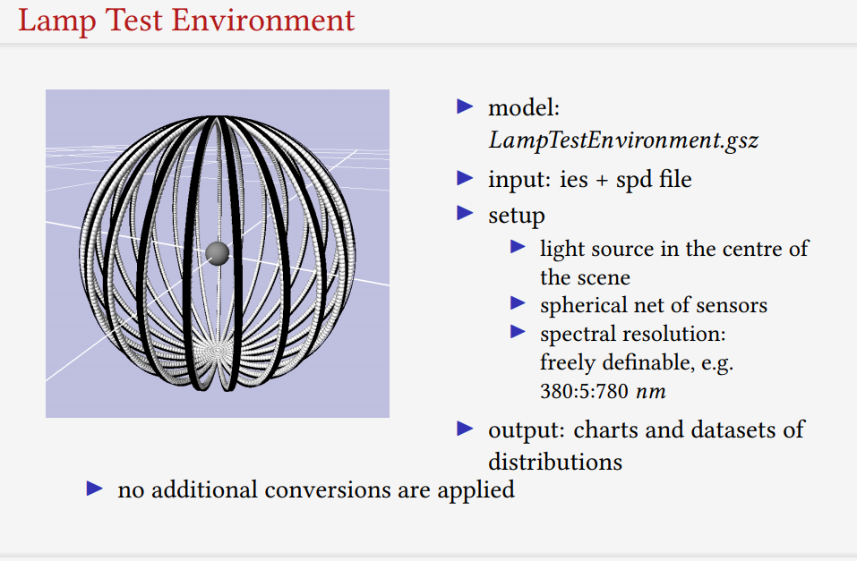
Virtual testing of lamp placement
Courtesy of
Michel Henke

Slide 8
Main features – LED light within tomato stands
Henke, de Visser

Slide 9
Hitz et al., 2019

Slide 10
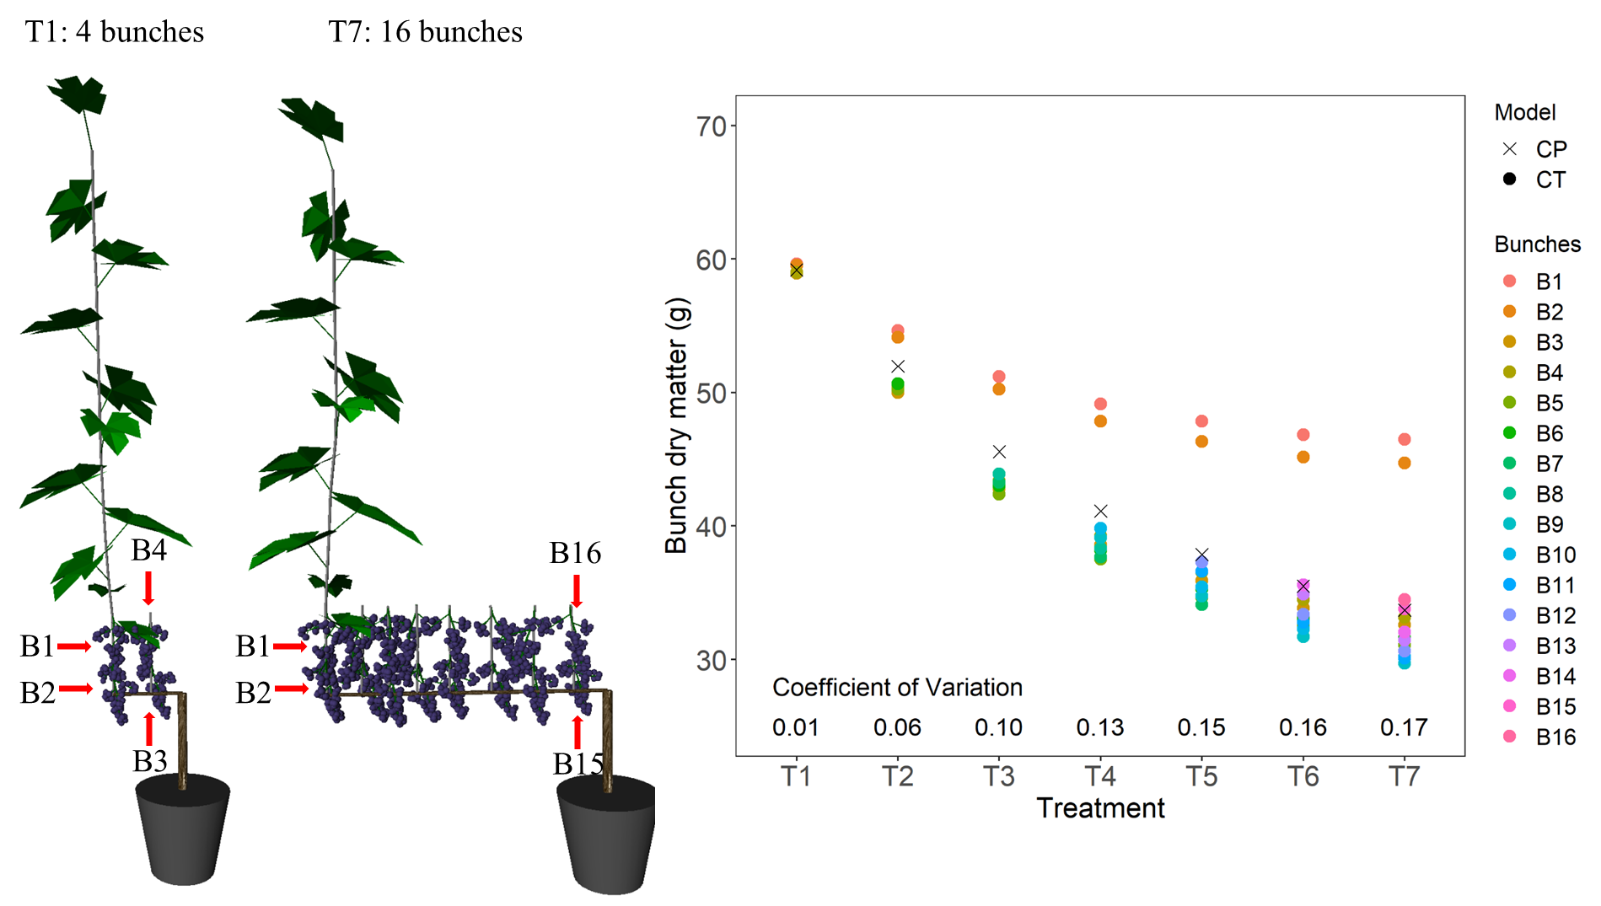
Notes:
Based on the calibrated model, we did a scenario simulation to test the ability of the model in capturing the gradient of phloem carbon concentration along the pathway.
I added five bunches along the cane but I only add one shoot with 10 leaves at the end of the cane to supply daily photosynthesis. Besides the leaves, trunk, root and internodes can supply non-structural carbon to berry growth as well.
You have three seconds to guess which bunch has the lowest biomass accumulation after 38 days?
The right answer is bunch 4. let ‘s see why?
16

Slide 11
Notes:
Based on the calibrated model, we did a scenario simulation to test the ability of the model in capturing the gradient of phloem carbon concentration along the pathway.
I added five bunches along the cane but I only add one shoot with 10 leaves at the end of the cane to supply daily photosynthesis. Besides the leaves, trunk, root and internodes can supply non-structural carbon to berry growth as well.
You have three seconds to guess which bunch has the lowest biomass accumulation after 38 days?
The right answer is bunch 4. let ‘s see why?
16

Slide 12
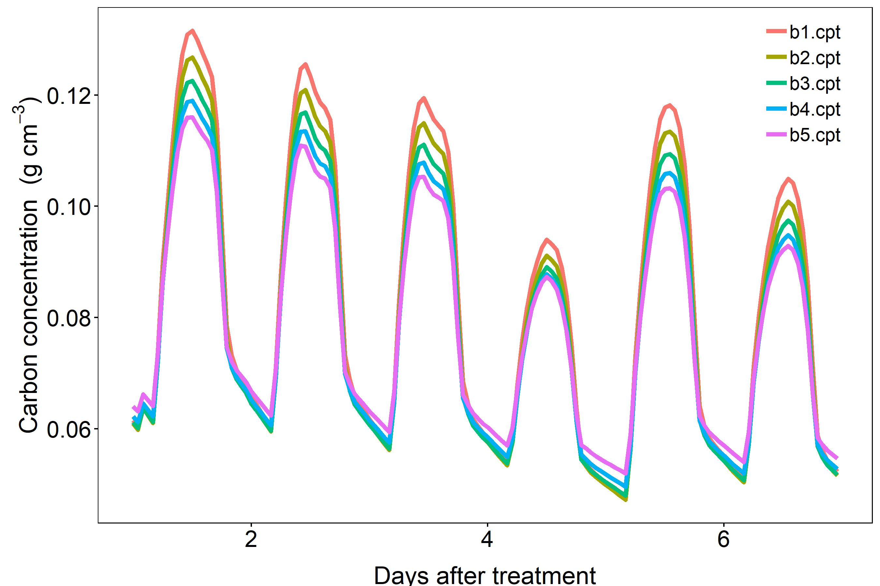
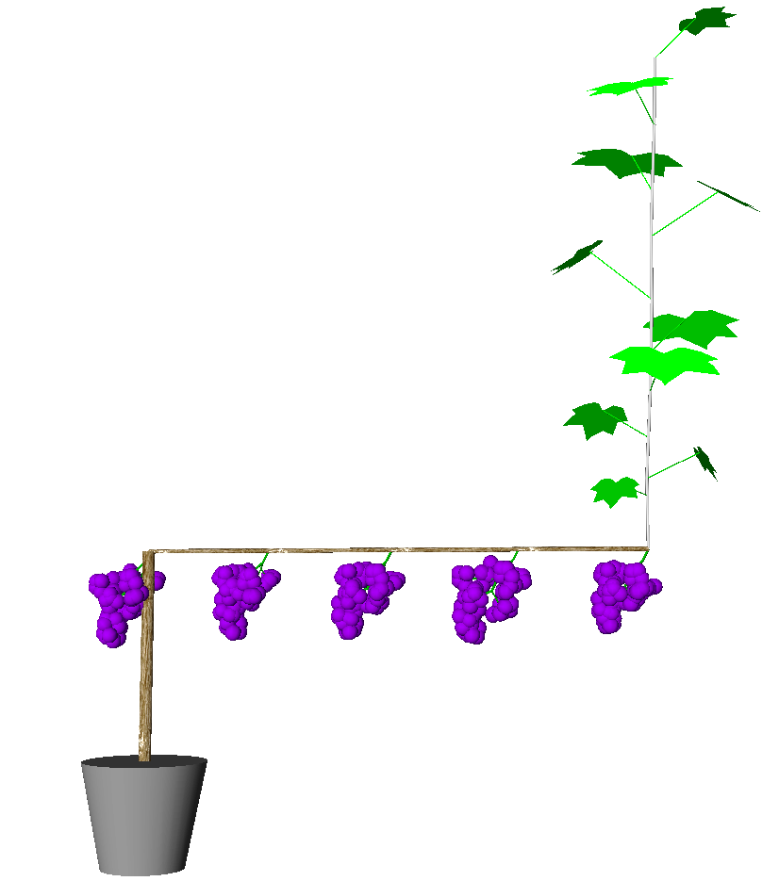
Diurnal phloem carbon concentrations
B5
B4
B3
B2
B1
Notes:
During the day, the phloem carbon concentrations close to the leaves increase more rapidly. We can see that the position where bunch 1 inserts has the phloem carbon concentrations during the middle of the day, and phloem carbon concentrations gradually decreases towards where bunch 5 inserts. During the night, the trend reveres, and the position close to the trunk and root has the highest phloem carbon concentration..
16

Slide 13
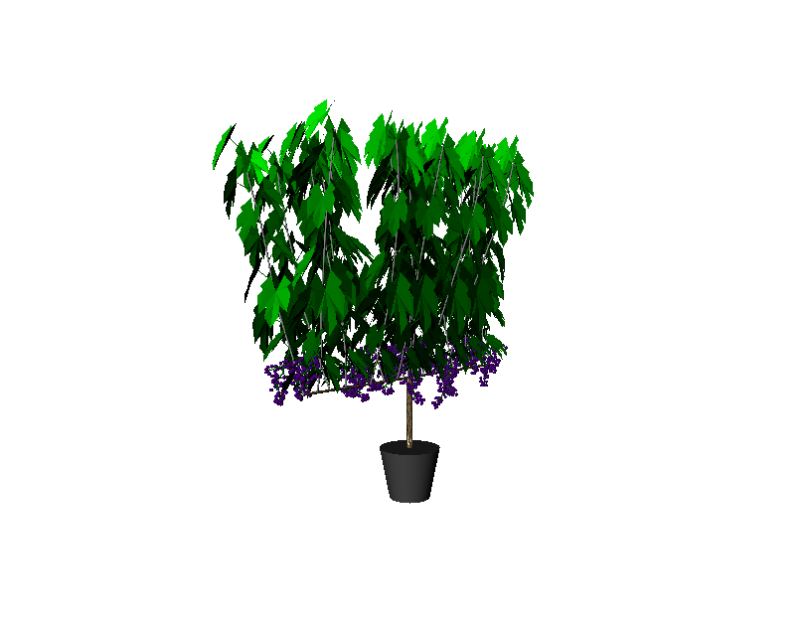
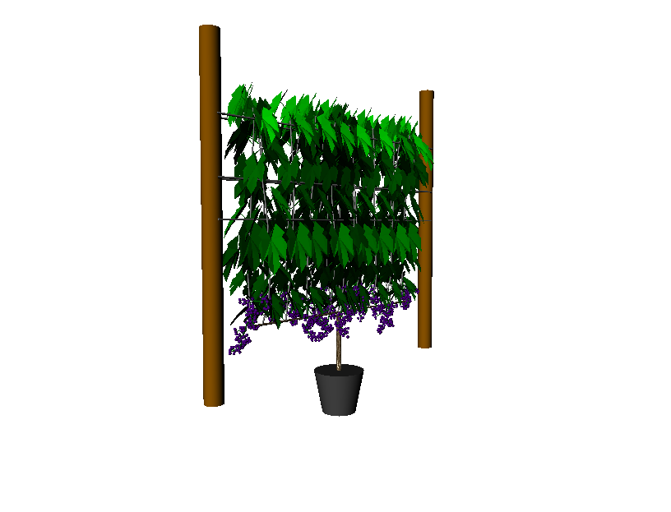
Wire Lifting
Identify shoots which need to be bent into shape
Calculate how much each joint between phytomers should bend
Notes:
Identify shoots that are in the right position to be lifted by the wires.
Apply bend to joint between two phytomers.
Work out how much joint should bend – related to rank of joint, number of joints below the wire on the shoot being bent.
16

Slide 14
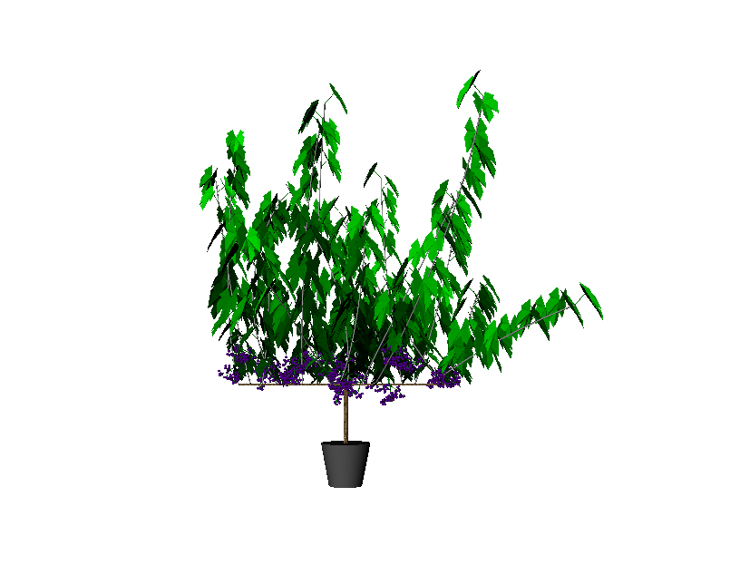
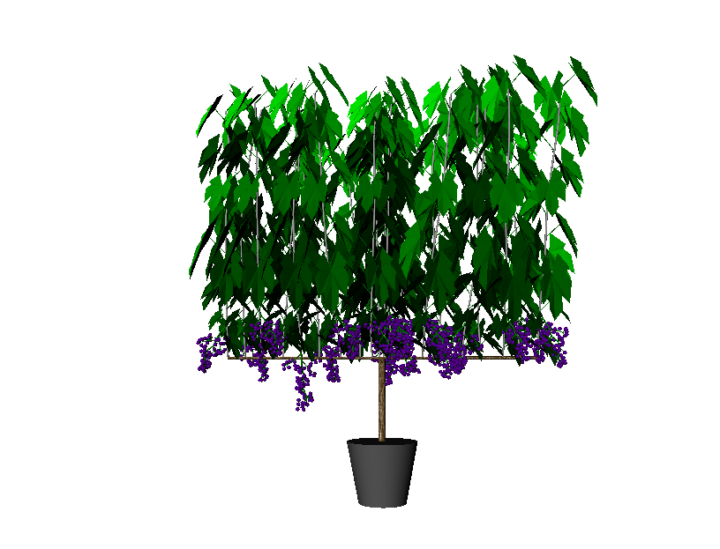
Structural Variation
Architecture originally developed based on fixed values or continuous uniform distribution
Multivariate normal distribution from Topvine data preserved relationships between parameters
Notes:
Plant structure initialized through rules using fixed values or continuous uniform distribution.
Many parameters related e.g. shoot length, elevation and curvature.
Multivariate normal distributions of shoot and leaf parameters from Topvine model preserved relationships between parameters.
16

Slide 15
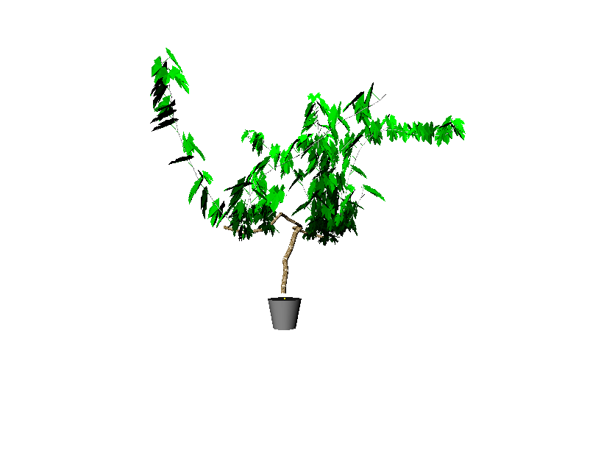
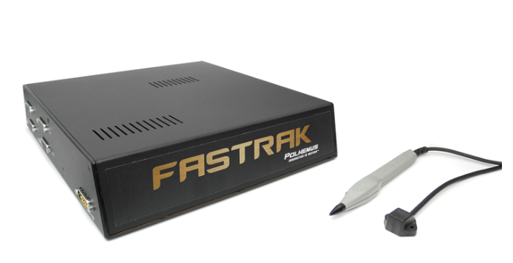
Reconstruction From Digitized Data
Aarthy Badrakalimuthu
Translating Cartesian coordinates into turtle geometry
Maintaining relationships between organs
© Fastrak 3D Digitizer
Notes:
Plant structure was initialized using a set of development rules e.g. at x distance along shoot produce a petiole at angle y.
Added option of instead initializing plant from digitized data by transforming digitalized data into turtle geometry system.
Preserved connections between organs for carbon flow and water transport.
16

Slide 16
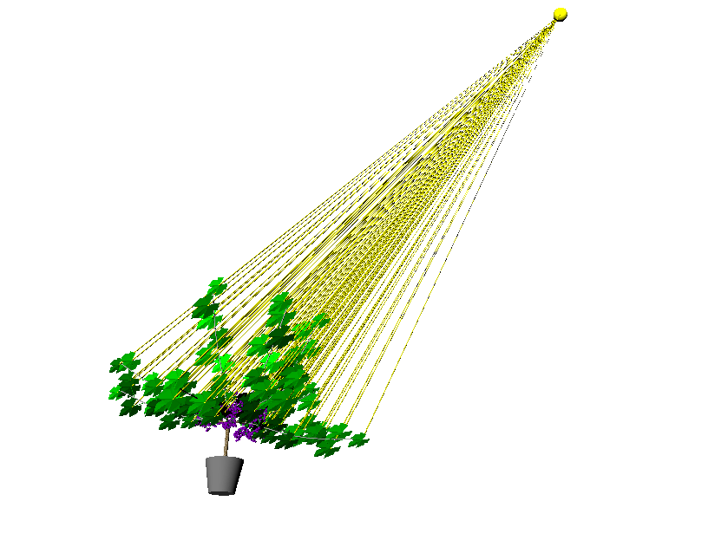
Leaf Angle Optimization
46 / 72 diffuse light sources
Leaf rotates towards direction with most light
15-16% increase in amount of light absorbed
Notes:
Added heliotropism of leaves to the simulation.
46 diffuse light sources – calculate how much light is received from each.
Rotate leaf towards direction from which most light was absorbed.
Only changed increased light absorbed by about 5-6% depending on the training system.
16

